Slide 1
Dr. SNS RAJALAKSHMI COLLEGE OF ARTS & SCIENCE (Autonomous)
Coimbatore -641049
Accredited by NAAC(Cycle–III) with ‘A+’ Grade
(Recognized by UGC, Approved by AICTE, New Delhi and
Affiliated to Bharathiar University, Coimbatore)
DEPARTMENT OF GRAPHIC AND CREATIVE DESIGN
COURSE NAME : OPERATING SYSTEM (21UCU404)
I YEAR /II SEMESTER
Unit V- Storage management
Topic 7 : Directory and Disk Structure

Slide 2
File Directories
Collection of files is a file directory. The directory contains information about the files, including attributes, location and ownership. Much of this information, especially that is concerned with storage, is managed by the operating system. The directory is itself a file, accessible by various file management routines.

Slide 3
File Directories
Information contained in a device directory are:
Name
Type
Address
Current length
Maximum length
Date last accessed
Date last updated
Owner id
Protection information

Slide 4
File Directories
Operation performed on directory are:
Search for a file
Create a file
Delete a file
List a directory
Rename a file
Traverse the file system

Slide 5
Advantages
Advantages of maintaining directories are:
Efficiency: A file can be located more quickly.
Naming: It becomes convenient for users as two users can have same name for different files or may have different name for same file.
Grouping: Logical grouping of files can be done by properties e.g. all java programs, all games etc.

Slide 6
Single-level Directory
In this a single directory is maintained for all the users.
Naming problem: Users cannot have same name for two files.
Grouping problem: Users cannot group files according to their need.

Slide 7
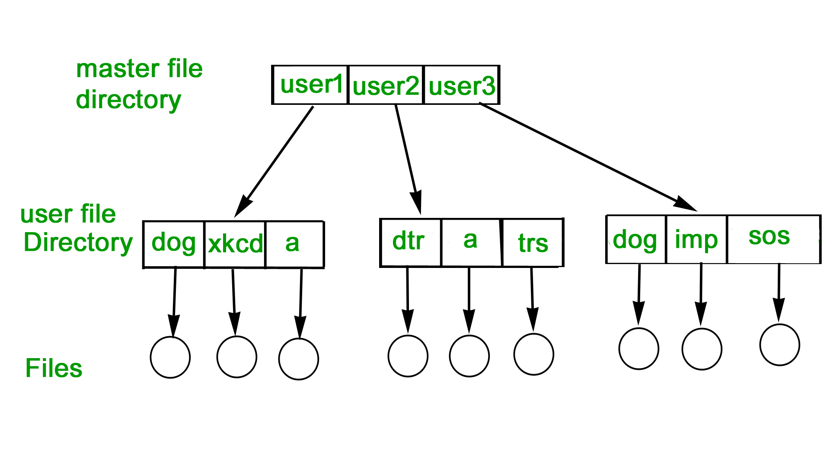
Two-level Directory
In this separate directories for each user is maintained.
Path name: Due to two levels there is a path name for every file to locate that file.
Now, we can have same file name for different user.
Searching is efficient in this method.

Slide 8
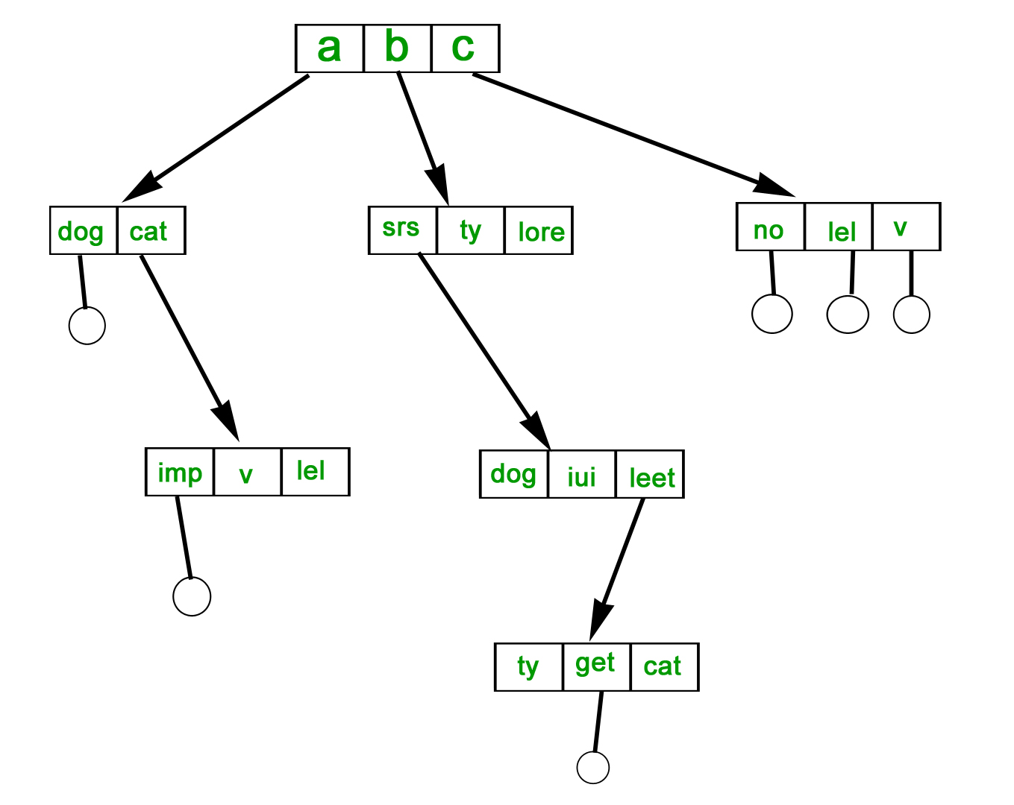
Tree-structured Directory
Directory is maintained in the form of a tree.
Searching is efficient and also there is grouping capability.
We have absolute or relative path name for a file.

Slide 9
Thank You

